Slide 1
Important Concepts

Slide 2
Contents
k means Clustering
Hierarchical clustering
DB Scan Clustering
PCA- Unsupervised learning algorithm

Slide 3
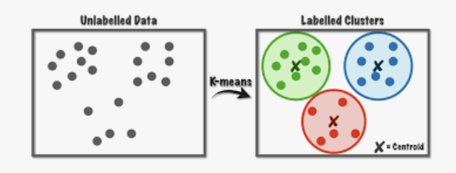
k Means clustering

Slide 4
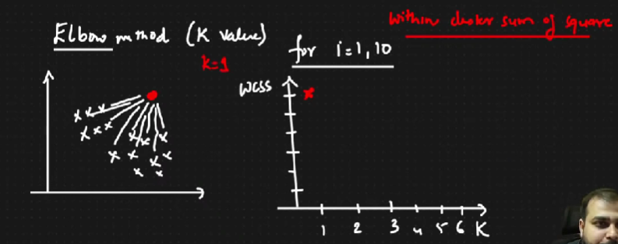
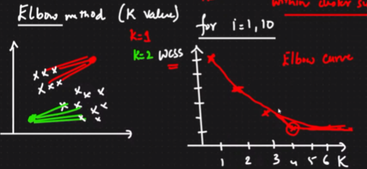
k Means clustering: Elbow Method

Slide 5
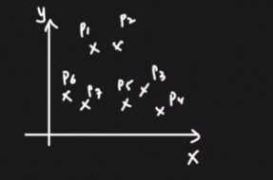
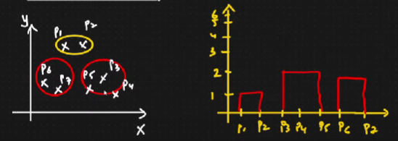
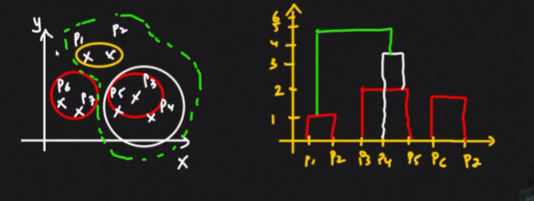
Hierarchical Clustering

Slide 6
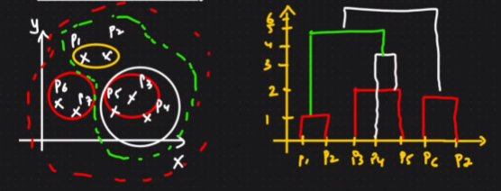

Hierarchical Clustering: Number of clusters

Slide 7
Time taken by hierarchical/k means clustering?
which one is more?
small: hierarchical
big: k means>hierarchical

Slide 8

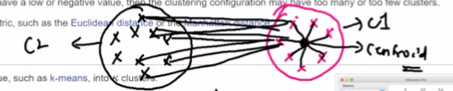

Performance Metrics: Validate clustering model
Silhouette (both hierarchical and k means): -1 to +1
Calculating a(i)
Calculate b(i) from the nearest cluster
Good model: b(i) >> a(i)

Slide 9
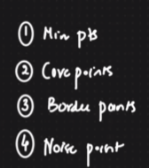

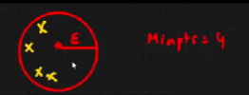
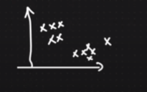
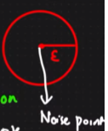
DB Scan Clustering: Can leave the outliers instead of assigning them into a cluster
Min points
Epsilon = radius of specific circle
Core points = if this circle has atleast 4
points, then its a core point
Border point= atleast 1

Slide 10
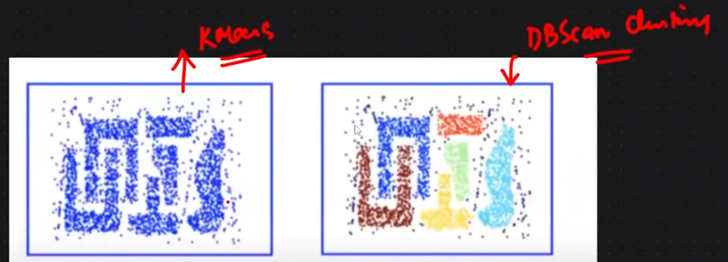
DB Scan Clustering

Slide 11
PCA
https://www.youtube.com/watch?v=HMOI_lkzW08

